Slide 1
Cricsheet Match Data Analysis
Prepared By: MUKESH KANNAN S

Slide 2
Project Objective
The Goal: To build an end-to-end data pipeline that transforms raw cricket match data (JSON) into actionable business insights.
Core Tasks:
Automated Data Acquisition.
Data Cleaning & Transformation (ETL).
Cloud Database Management (TiDB).
Exploratory Data Analysis (EDA).
Interactive Visual Storytelling.

Slide 3
Technical Architecture
Data Source: Cricsheet (JSON format).
Extraction: Python & Selenium / Bulk Download.
Processing: Pandas for flattening nested JSON structures.
Storage: TiDB Cloud (MySQL-compatible) for scalable data hosting.
Visualization: Power BI Desktop connected via MySQL Connector.

Slide 4
Data Transformation (ETL)
Challenges: Cricsheet data is deeply nested (Innings > Overs > Deliveries).
Solution: Developed a Python script to:
Parse metadata (teams, venue, outcome).
Flatten ball-by-ball records into a tabular format.
Handle "Reserved Keywords" (like the over column) for SQL compatibility.

Slide 5
SQL Analysis
Implemented 20 optimized SQL queries to extract specific metrics:
Player Performance: Top 10 run-scorers and leading wicket-takers.
Efficiency: Strike rates for batters and economy rates for bowlers.
Match Trends: Impact of winning the toss on match outcomes.
Winning Margins: Identifying the most dominant victories by runs/wickets.

Slide 6
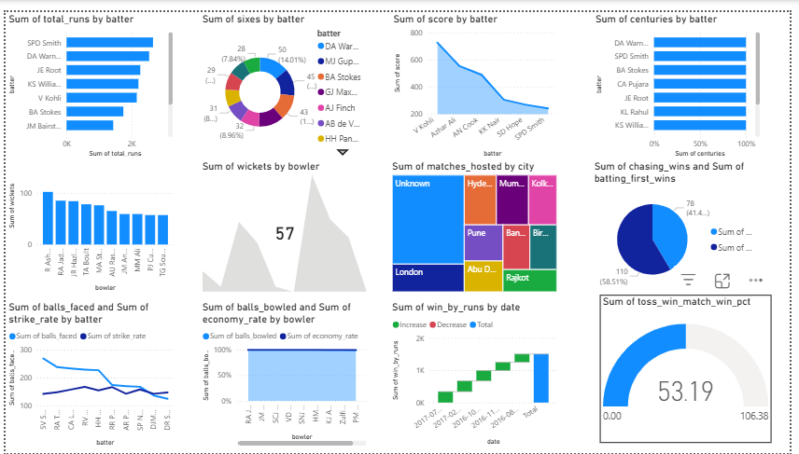
Power BI Dashboard Showcase
Features:
Dynamic Slicers: Toggle between T20, ODI, and Test formats.
Interactive Cards: Real-time calculation of Tournament Total Runs.
Team Analysis: Visual comparison of wins across different franchises/nations.

Slide 7
Conclusion
Successfully automated a complex data workflow.
Demonstrated proficiency in Python, Cloud SQL, and Data Visualization.
The system is scalable to include future match data with minimal code changes.

Slide 8
THANK YOU

